Slide 1
America’s History
Chapter 29 (only TWO more chapters)

Slide 2
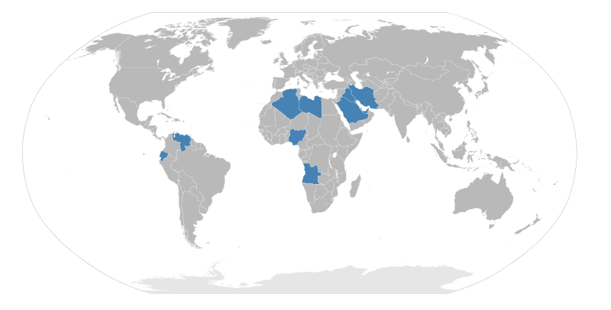
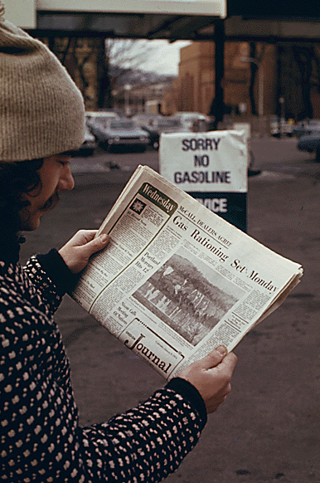
An Era of Limits
The economy of the 1970s was plagued by stagflation - high interest rates, unemployment, and slow economic growth
Energy Crisis
Organization of Petroleum Exporting Countries (OPEC)
Many Middle Eastern countries
Formed to control the supply and price of oil
Yom Kippur War (1973)
US supported Israel against Egypt and Syria, led to an oil embargo
Gas prices soared, long lines at stations
Speed limit was reduced to 55
Sales of smaller, foreign cars began to increase

Slide 3
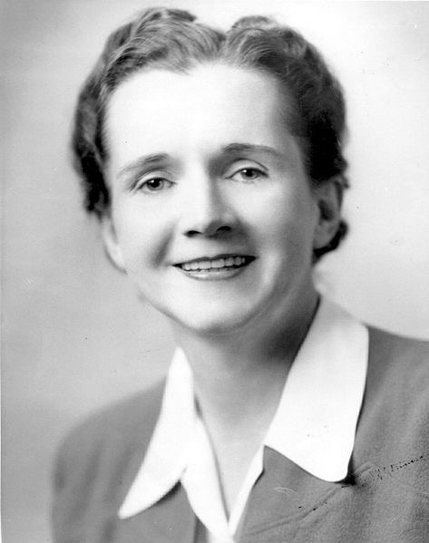
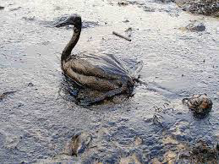
An Era of Limits
Environmentalism
Focused on preservation and conservation of the environment
Silent Spring - (could be a GREAT stimulus for multiple-choice)
Written by Rachel Carson (1962) - exposed the dangers of pesticides (DDT) on the environment
Helped lead to the
Environmental Protection Agency (EPA):
Created under Nixon’s Administration, helped regulate businesses and their impact on the environment
Clean Air Act (1970):
Allowed the EPA to regulate air emissions by companies

Slide 4
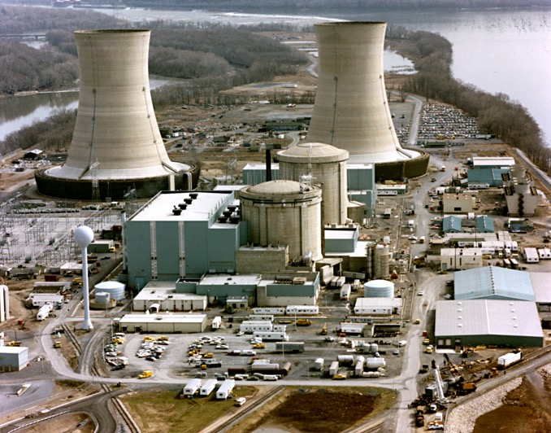
An Era of Limits
Nuclear Power
Originally seen as an alternative to other energy forms
Environmentalists were concerned with the dangers of nuclear plants
Three Mile Island (PA) - 100,000 people were forced to flee their homes

Slide 5
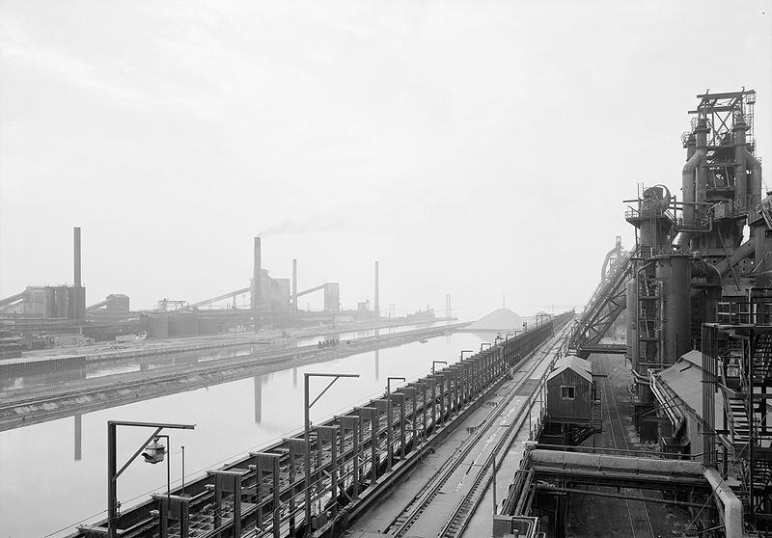
An Era of Limits
Economic Transformation
Vietnam War + Great Society = deficit and inflation
US began to transform from a manufacturing economy to a service economy
Stagflation was rampant in the 1970s
1971 - Nixon removed the US from the gold standard
Who advocated changing the gold standard in the late 19th century?

Slide 6
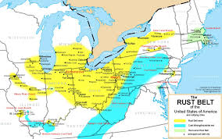
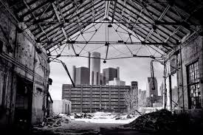
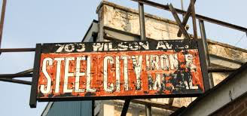
An Era of Limits
Deindustrialization
Steel production fell drastically, foreign steel was cheaper than American
Rust Belt - area in the Northeast that saw a decline in industrial production
What’s another famous “belt?”
***Sunbelt***
Organized Labor in Decline
The loss of many industrial jobs hurt the labor movement
Unions focused on saving jobs, as opposed to gaining higher wages

Slide 7
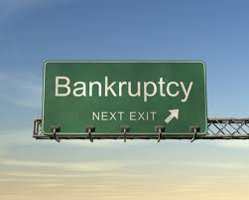
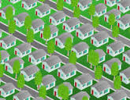
An Era of Limits
Urban Crisis and Suburban Revolt
An increase in suburbs left less revenue for cities, which left many grappling to pay bills
NYC almost declared bankruptcy in 1975
Impact of the growth of suburbs?
Growth of shopping centers, businesses moved to suburbs as well

Slide 8
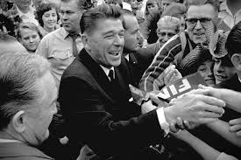
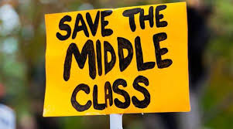
An Era of Limits
Tax Revolt:
Major component (and victory - N.C.) of the conservative movement
Proposition 13 in California changed taxes
Capped property taxes, increased requirements for tax measures to be 2/3 in the legislature
Example of a referendum - famous Progressive associated with this idea?
Labor trends beginning in the 1970s?
A large number low-wage earners; high wage earners at the top; decreasing number in the middle

Slide 9
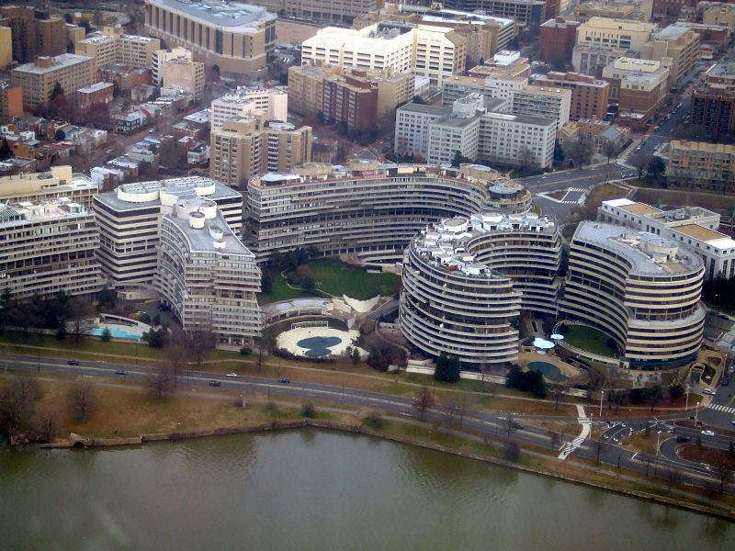
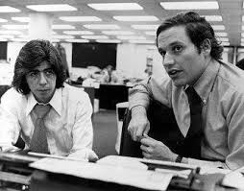
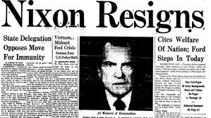
Politics in Flux, 1973 - 1980
Watergate and the Fall of a President
June 17, 1972: break in at the Democratic National Headquarters at the Watergate Complex
The architects of the plan worked for Nixon’s Committee to Re-Elect the President (CREEP)
Nixon helped obstruct the investigation
Woodward and Bernstein helped blow the top off of the scandal
August 9, 1974 - Nixon became the first president to resign
He was NOT impeached

Slide 10
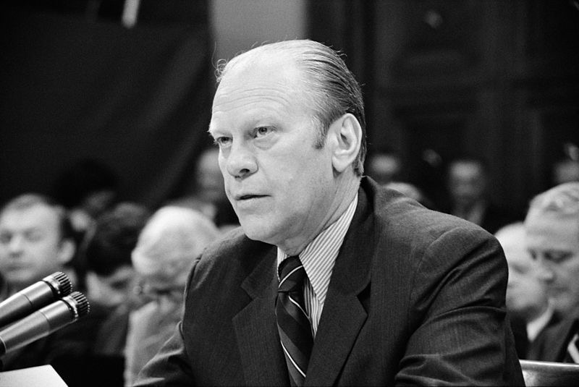
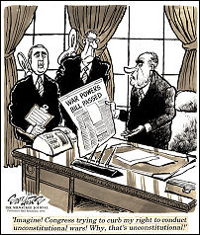
Politics in Flux, 1973 - 1980
Gerald Ford, the Nixon’s VP became president and granted Nixon a pardon
This infuriated many Americans
Helped lead to more distrust of government
Limiting the power of the president
War Powers Act (1973)
Passed over Nixon’s veto, limited the ability of the President to send troops into combat
Contrast with the Gulf of Tonkin Resolution of only 9 years earlier
Freedom of Information Act - citizens (especially journalists) could gain access to federal records

Slide 11
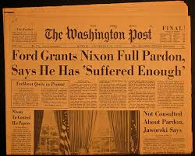
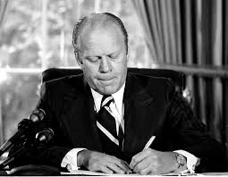
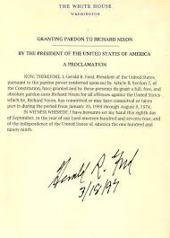
Politics in Flux, 1973 - 1980
Watergate Babies
Many Democrats benefitted in the 1974 midterm election from Ford’s pardon of Nixon
These elected officials helped reform politics and bring greater transparency:
Eliminated HUAC
Ethics in Government Act - politicians had to disclose financial contributions
Political Realignment
1970s conservatives focused on tax cuts and deregulation to stimulate the economy
Deindustrialization led to population growth in the Sunbelt
States such as NY lost political influence, whereas CA gained a significant amount

Slide 12
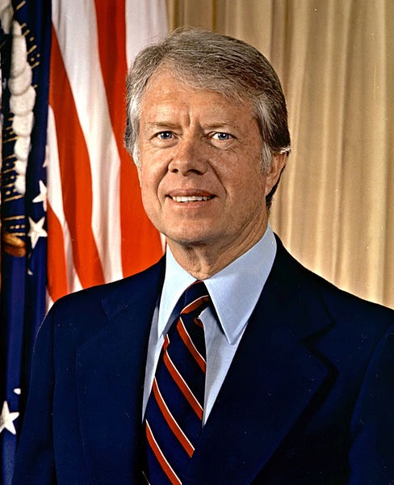
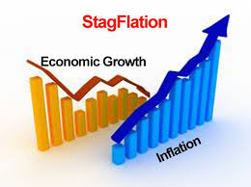
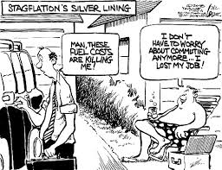
Politics in Flux, 1973 - 1980
Jimmy Carter: The Outsider as President
As a governor of Georgia, Carter campaigned as a “Washington Outsider”
One who was not associated with scandals and politics of D.C.
Much of the Carter administration was plagued by stagflation

Slide 13
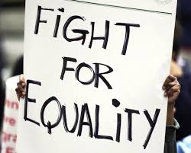
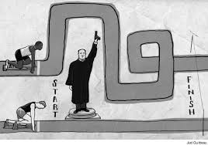
Reform and Reaction in the 1970s
Civil Rights in a New Era
Affirmative Action:
Sought to combat racial discrimination by taking into account minority groups
Advocated by the JFK and LBJ administrations
Government contractors were encouraged to recruit racial minorities for jobs

Slide 14
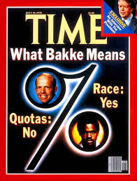
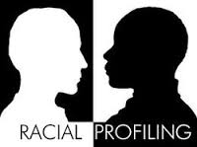
Reform and Reaction in the 1970s
Bakke v. University of California:
The Supreme Court upheld the idea of affirmative action, but rejected a quota system for minorities

Slide 15
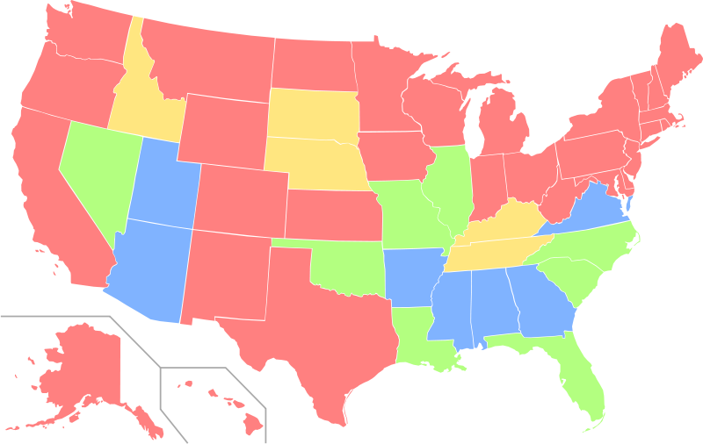
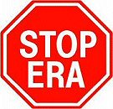
Reform and Reaction in the 1970s
The Women’s Movement and Gay Rights
Women’s Activism
Women’s groups made significant gains in the 1970s
Universities such as Yale became co-ed
New clinics and rape centers were established around the US
Equal Rights Amendment
Introduced in 1923 (Alice Paul), it passed both houses of Congress in 1972
Phyllis Schlafly - sought to stop the ERA
She advocated traditional roles for women, feared the amendment would lead to unisex bathrooms and women bring drafted into the military
The ERA was never ratified - fell 3 states shy of ratification

Slide 16
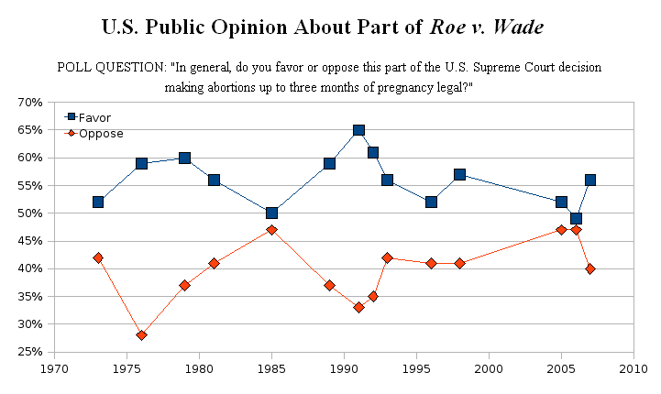
Reform and Reaction in the 1970s
Roe v. Wade
Throughout the 1960s, abortion was illegal in almost every state
Griswold v. Connecticut - Supreme Court struck down a law forbidding contraceptives, established the idea of “Right to Privacy”
Roe v. Wade (1973) - struck down a Texas law, declared abortion legal within the first trimester of a pregnancy
Debates over the decision still exist today

Slide 17
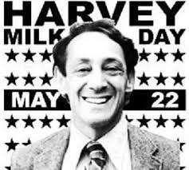
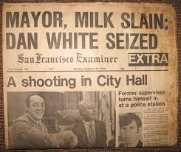
Reform and Reaction in the 1970s
Harvey Milk
An openly gay candidate, Milk won a city council seat in 1977 in San Francisco
Became a powerful symbol for the gay rights movement
In 1978, he and the mayor of San Francisco were assassinated

Slide 18
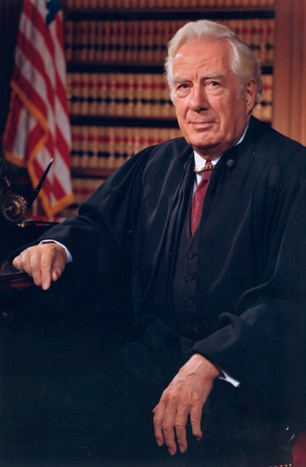
Reform and Reaction in the 1970s
After the Warren Court
Nixon appointed four new justices to the Supreme Court, including Chief Justice Warren Burger
Nixon and supporters hoped the court would be more conservative than its predecessor, the Warren Court
In many ways, the Burger Court upheld ideas and precedents of the Warren Court
Roe v. Wade used the “right to privacy” idea of the Warren Court

Slide 19
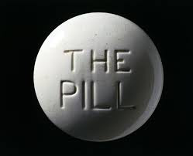
The American Family on Trial
Navigating the Sexual Revolution
3 factors that increased discussions about sex:
Birth control pill
Counterculture of the baby boom generation
Feminism influence
Women’s Rights focused on a revolution in sexual values, not just behavior

Slide 20
The American Family on Trial
Sex and Popular Culture
Books, movies, and TV shows increasingly focused on sex in the 1970s
Middle-Class Marriage
A new therapy industry emerged that focused on counseling married couples
Made up of churches and secular groups

Slide 21
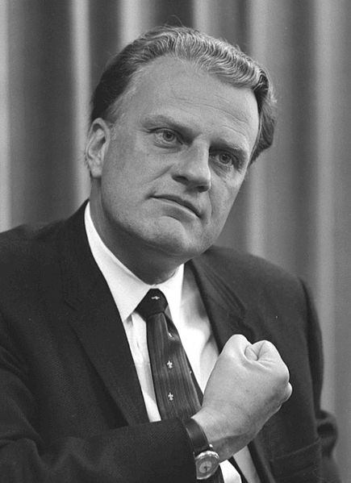
The American Family on Trial
Religion in the 1970s: The Fourth Great Awakening
Quick review: impact of the 2nd Great Awakening?
Inspired reform movements - abolition, women’s rights, temperance, etc.
Evangelical Resurgence
Evangelic churches - “born again”, focused on strictly interpreting the bible
Billy Graham - spent much of the 1940s and 1950s traveling across the country
What led to the revival in the 1970s?
Rising divorce rates, social unrest, and perceived moral decay

Slide 22
The American Family on Trial
Religion and the Family
Evangelicals focused on the nuclear family - father as the breadwinner, mother as supporter
Evangelicals were alarmed with sex education, abortion, and higher divorce rates

Slide 23
The Recap
OPEC and the Oil Crisis of 1973
Rachel Carson and Silent Spring
EPA
Stagflation
Deindustrialization
Watergate -> Nixon’s Resignation -> Ford’s Pardon of Nixon
Jimmy Carter as a “Washington Outsider”
Bakke v. University of California
Equal Rights Amendment and Phyllis Schlafly
Roe v. Wade
Harvey Milk
Reasons for the rise of Evangelicalism

